Slide 1
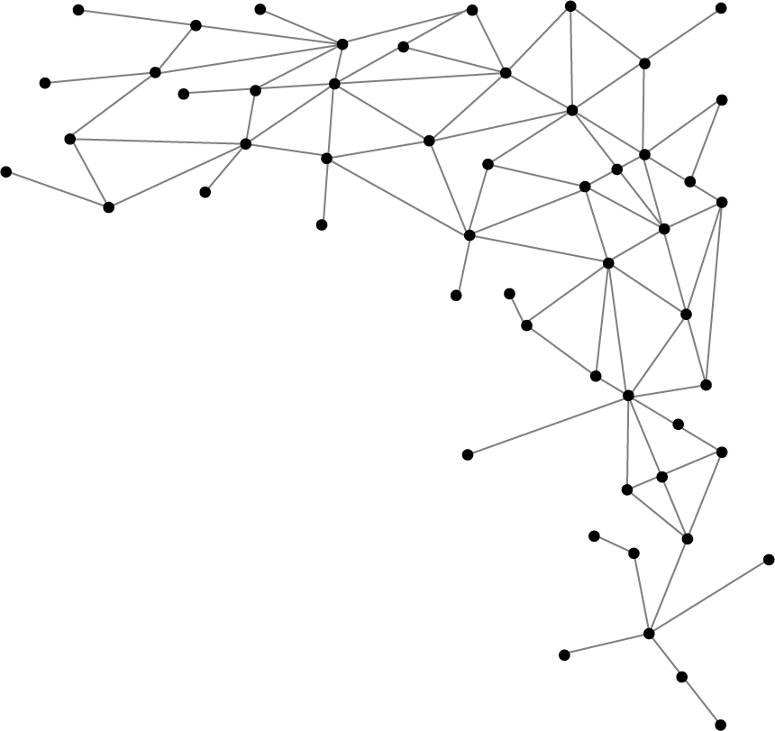




Machine Learning
I am Saif Hassan
Lecturer (CS@SIBAU)
@saifhassandr
@saifhassandr

Slide 2
Agenda
Overfitting/Underfitting
Fixed / Hold-Out Method
k-fold Cross-Validation
Leave-One-Out Cross Validation
Accuracy / AUC-ROC Curve

Slide 3
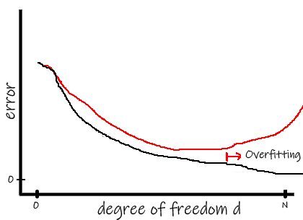
Overfitting
Low error on Training Data
High error on Test Data
Train Error
Test Error
Notes:
How to avoid overfitting
Cross Validation
Training with more data
Removing features
Early stopping
Regularizations
Ensembling
How to detect overfitting
Only way is to test on unseen data

Slide 4
Underfitting
High error on Training Data
High error on Test Data

Slide 5
Evaluation
Fixed / Hold-Out Method
k-fold Cross-Validation
Leave-One-Out Cross Validation

Slide 6
Fixed / Hold-Out - Evaluation
Dataset is divided into:
Train and Test
Model is trained on train data
Model is evaluated on test Data (Unseen)
70%
80%
30%
20%

Slide 7
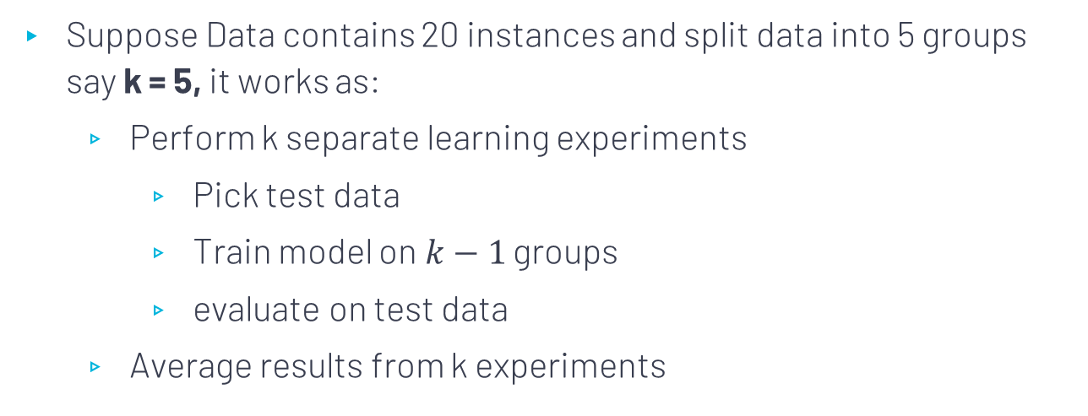
k-fold Cross-Validation- Evaluation
Suppose Data contains 20 instances and split data into 5 groups say k = 5, it works as:
Perform k separate learning experiments
Pick test data
Train model on$k−1$ groups
evaluate on test data
Average results from k experiments

Slide 8
k-fold cross validation
S. No# | Outlook | Temp | Humidity | Windy | Play
1 | overcast | hot | high | FALSE | yes
2 | overcast | cool | normal | TRUE | yes
3 | overcast | mild | high | TRUE | yes
4 | overcast | hot | normal | FALSE | yes
5 | rainy | mild | high | FALSE | yes
6 | rainy | cool | normal | FALSE | yes
7 | rainy | cool | normal | TRUE | no
8 | rainy | mild | normal | FALSE | yes
9 | rainy | mild | high | TRUE | no
10 | sunny | hot | high | FALSE | no
11 | sunny | hot | high | TRUE | no
12 | sunny | mild | high | FALSE | no
13 | sunny | cool | normal | FALSE | yes
14 | sunny | mild | normal | TRUE | Yes
15 | overcast | cool | high | TRUE | no
16 | overcast | hot | normal | True | yes
17 | rainy | cool | High | FALSE | no
18 | sunny | mild | Normal | FALSE | no
19 | overcast | hot | High | TRUE | yes
20 | sunny | hot | Normal | FALSE | no
First iteration
Test Data
Train Data

Slide 9
k-fold cross validation
S. No# | Outlook | Temp | Humidity | Windy | Play
1 | overcast | hot | high | FALSE | yes
2 | overcast | cool | normal | TRUE | yes
3 | overcast | mild | high | TRUE | yes
4 | overcast | hot | normal | FALSE | yes
5 | rainy | mild | high | FALSE | yes
6 | rainy | cool | normal | FALSE | yes
7 | rainy | cool | normal | TRUE | no
8 | rainy | mild | normal | FALSE | yes
9 | rainy | mild | high | TRUE | no
10 | sunny | hot | high | FALSE | no
11 | sunny | hot | high | TRUE | no
12 | sunny | mild | high | FALSE | no
13 | sunny | cool | normal | FALSE | yes
14 | sunny | mild | normal | TRUE | Yes
15 | overcast | cool | high | TRUE | no
16 | overcast | hot | normal | True | yes
17 | rainy | cool | High | FALSE | no
18 | sunny | mild | Normal | FALSE | no
19 | overcast | hot | High | TRUE | yes
20 | sunny | hot | Normal | FALSE | no
Second iteration
Test Data
Train Data

Slide 10
k-fold cross validation
S. No# | Outlook | Temp | Humidity | Windy | Play
1 | overcast | hot | high | FALSE | yes
2 | overcast | cool | normal | TRUE | yes
3 | overcast | mild | high | TRUE | yes
4 | overcast | hot | normal | FALSE | yes
5 | rainy | mild | high | FALSE | yes
6 | rainy | cool | normal | FALSE | yes
7 | rainy | cool | normal | TRUE | no
8 | rainy | mild | normal | FALSE | yes
9 | rainy | mild | high | TRUE | no
10 | sunny | hot | high | FALSE | no
11 | sunny | hot | high | TRUE | no
12 | sunny | mild | high | FALSE | no
13 | sunny | cool | normal | FALSE | yes
14 | sunny | mild | normal | TRUE | Yes
15 | overcast | cool | high | TRUE | no
16 | overcast | hot | normal | True | yes
17 | rainy | cool | High | FALSE | no
18 | sunny | mild | Normal | FALSE | no
19 | overcast | hot | High | TRUE | yes
20 | sunny | hot | Normal | FALSE | no
Third iteration
Test Data
Train Data

Slide 11
k-fold cross validation
S. No# | Outlook | Temp | Humidity | Windy | Play
1 | overcast | hot | high | FALSE | yes
2 | overcast | cool | normal | TRUE | yes
3 | overcast | mild | high | TRUE | yes
4 | overcast | hot | normal | FALSE | yes
5 | rainy | mild | high | FALSE | yes
6 | rainy | cool | normal | FALSE | yes
7 | rainy | cool | normal | TRUE | no
8 | rainy | mild | normal | FALSE | yes
9 | rainy | mild | high | TRUE | no
10 | sunny | hot | high | FALSE | no
11 | sunny | hot | high | TRUE | no
12 | sunny | mild | high | FALSE | no
13 | sunny | cool | normal | FALSE | yes
14 | sunny | mild | normal | TRUE | Yes
15 | overcast | cool | high | TRUE | no
16 | overcast | hot | normal | True | yes
17 | rainy | cool | High | FALSE | no
18 | sunny | mild | Normal | FALSE | no
19 | overcast | hot | High | TRUE | yes
20 | sunny | hot | Normal | FALSE | no
Fourth iteration
Test Data
Train Data

Slide 12
k-fold cross validation
S. No# | Outlook | Temp | Humidity | Windy | Play
1 | overcast | hot | high | FALSE | yes
2 | overcast | cool | normal | TRUE | yes
3 | overcast | mild | high | TRUE | yes
4 | overcast | hot | normal | FALSE | yes
5 | rainy | mild | high | FALSE | yes
6 | rainy | cool | normal | FALSE | yes
7 | rainy | cool | normal | TRUE | no
8 | rainy | mild | normal | FALSE | yes
9 | rainy | mild | high | TRUE | no
10 | sunny | hot | high | FALSE | no
11 | sunny | hot | high | TRUE | no
12 | sunny | mild | high | FALSE | no
13 | sunny | cool | normal | FALSE | yes
14 | sunny | mild | normal | TRUE | Yes
15 | overcast | cool | high | TRUE | no
16 | overcast | hot | normal | True | yes
17 | rainy | cool | High | FALSE | no
18 | sunny | mild | Normal | FALSE | no
19 | overcast | hot | High | TRUE | yes
20 | sunny | hot | Normal | FALSE | no
Fifth iteration
Test Data
Train Data

Slide 13
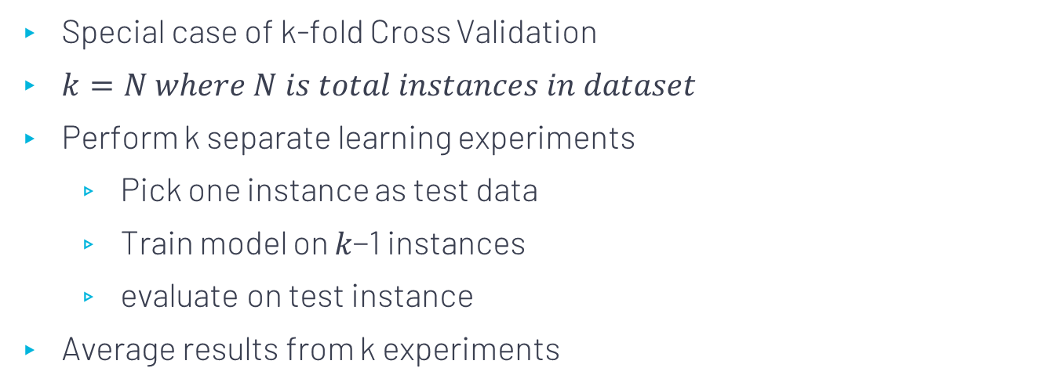
Leave-One-Out Cross Validation
Special case of k-fold Cross Validation
$k=N where N is total instances in dataset$
Perform k separate learning experiments
Pick one instance as test data
Train model on 𝑘−1 instances
evaluate on test instance
Average results from k experiments

Slide 14
Leave-One-Out Cross Validation
S. No# | Outlook | Temp | Humidity | Windy | Play
1 | overcast | hot | high | FALSE | yes
2 | overcast | cool | normal | TRUE | yes
3 | overcast | mild | high | TRUE | yes
4 | overcast | hot | normal | FALSE | yes
5 | rainy | mild | high | FALSE | yes
6 | rainy | cool | normal | FALSE | yes
7 | rainy | cool | normal | TRUE | no
8 | rainy | mild | normal | FALSE | yes
9 | rainy | mild | high | TRUE | no
10 | sunny | hot | high | FALSE | no
11 | sunny | hot | high | TRUE | no
12 | sunny | mild | high | FALSE | no
13 | sunny | cool | normal | FALSE | yes
14 | sunny | mild | normal | TRUE | Yes
15 | overcast | cool | high | TRUE | no
16 | overcast | hot | normal | True | yes
17 | rainy | cool | High | FALSE | no
18 | sunny | mild | Normal | FALSE | no
19 | overcast | hot | High | TRUE | yes
20 | sunny | hot | Normal | FALSE | no
Training iterations ← Total Instances
Pros & Cons
Good way to evaluate
High computation time

Slide 15
Evaluation
Accuracy – Confusion Matrix
AUC – ROC Curve

Slide 16
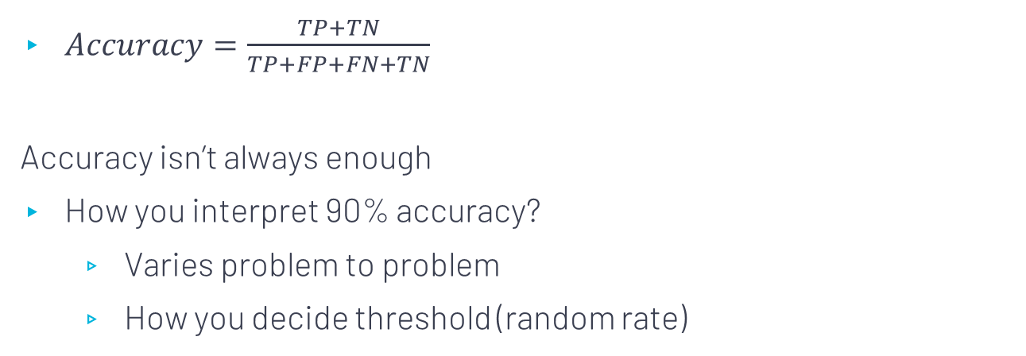
Accuracy
$Accuracy=\frac{TP+TN}{TP+FP+FN+TN}$
Accuracy isn’t always enough
How you interpret 90% accuracy?
Varies problem to problem
How you decide threshold (random rate)
 | Actual Yes | Actual No
Predicted Yes | TP | FP
Predicted No | FN | TN

Slide 17
AUC-ROC Curve
Evaluation metric for classification model’s performance
ROC is probability curve
AUC measures how much models is able to separate two classes
Higher the AUC better the model is predicting right
TPR/Sensitivity, Specificity, FPR

Slide 18

Formulas – AUC/ROC Curve
 | Actual Yes | Actual No
Predicted Yes | TP | FP
Predicted No | FN | TN
TPR / Sensitivity $=\frac{TP}{TP+FN}$
Specificity $=\frac{TN}{TN+FP}$
FPR $=1−Specificity$
$=\frac{FP}{TN+FP}$

Slide 19
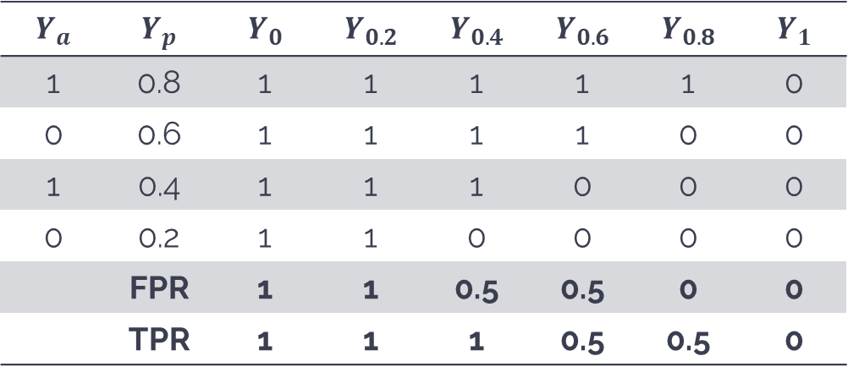
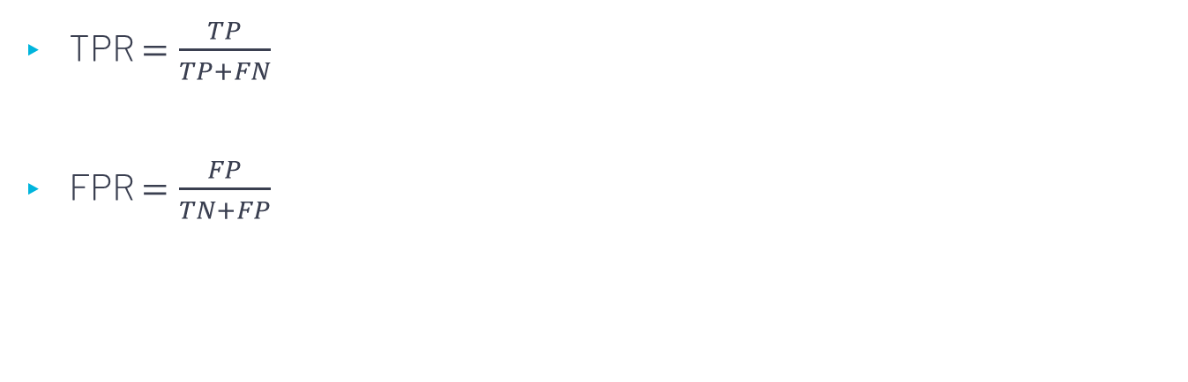
Example – AUC – ROC Curve
$$Y_{a}$$ | $$Y_{p}$$ | $$Y_{0}$$ | $$Y_{0.2}$$ | $$Y_{0.4}$$ | $$Y_{0.6}$$ | $$Y_{0.8}$$ | $$Y_{1}$$
1 | 0.8 | 1 | 1 | 1 | 1 | 1 | 0
0 | 0.6 | 1 | 1 | 1 | 1 | 0 | 0
1 | 0.4 | 1 | 1 | 1 | 0 | 0 | 0
0 | 0.2 | 1 | 1 | 0 | 0 | 0 | 0
 | FPR | 1 | 1 | 0.5 | 0.5 | 0 | 0
 | TPR | 1 | 1 | 1 | 0.5 | 0.5 | 0
TPR $=\frac{TP}{TP+FN}$
FPR $=\frac{FP}{TN+FP}$

Slide 20
Plotting ROC – AUC Curve

Slide 21
THANKS!
@saifhassandr
Any questions?
Leave comments below.

